Slide 1
DTSA 5509 Final Project
Presented by: Anubhav Sharma
Last Updated: May 2nd, 2023
Notes:
Hello

Slide 2
Table of Contents
Introduction: Project Topic and Data Set
Part 1: Data Cleaning
Part 2: Exploratory Data Analysis(EDA)
Part 3: Models
Part 4: Result and Analysis
Part 5: Conclusion
Appendix

Slide 3
Introduction

Slide 4
Objective
Overview of the Problem and the Data
Cleaning the Data Set
Performing basic EDA
Fit various kinds of Supervised learning Models on the Training Dataset
Result and Analysis of different Models
Choosing the best Model as the solution of the problem

Slide 5
Diabetes Prediction
Various Health Care professionals are interesting in predicting diabetes for the patients based on their medical history and demographic information. This can be useful for healthcare professionals in identifying patients who may be at risk of developing diabetes and in developing personalized treatment plans.
Besides Health Care professionals pharmaceutical companies are also interested in predicting the patients contacting diabetes so that they can do customer profiling.
In this project we will specifically focus on predicting Diabetes on the basis of various predictors. For this we will compare Accuracy score of various models and pick the most accurate model.

Slide 6
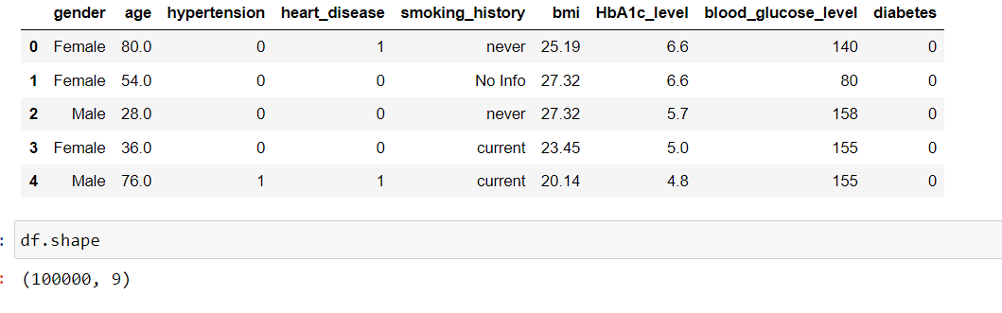
Diabetes Prediction Dataset
The Diabetes prediction dataset is a collection of medical and demographic data from patients, along with their diabetes status (positive or negative). The data includes features such as age, gender, body mass index (BMI), hypertension, heart disease, smoking history, HbA1c level, and blood glucose level.
The given data set can be used for Inferential and Prediction, however for this assignment we will cover Prediction use of the data specifically.

Slide 7
Part 1: Data Cleaning

Slide 8
Data Cleaning
Data Cleaning step is very important as most of the further operations can only be done on Tidy data. In this Part we will analyse the Data Types, correct them if needed, and find the None values.
For the Null Values, if a Predictor has less than 5% Observation values as Null we will impute the values with the Mean, Median, or Mode, as necessary. And for the Predictors having more null values, we will remove them after careful consideration. (In such cases if we have high amount of null value but still want to use that Predictor it will be better to go back to Data Cleaning Step)

Slide 9
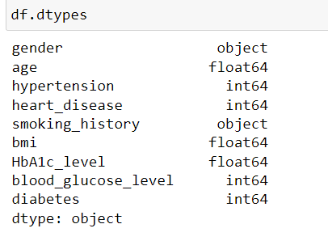
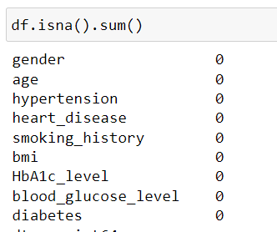
Data Cleaning
After looking at the default data type below we adjusted them so that predictors such as age and blood_glucose_level appears properly.
We also preliminary checked the None values.

Slide 10
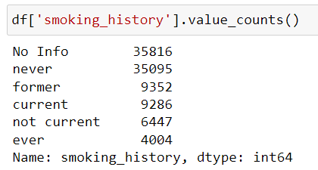
Data Cleaning
There does not seem to be any python based null value. However, after checking the object types, especially the smoking_history we were able to find 35,816 rows where we have No info.
While No Info also represent a dimension of information we can not impute it if more than 30% of the Observations have None value. If Health Care experts believe that it is an essential predictor, they will have to improve the collection method so that the information can be captured properly.

Slide 11
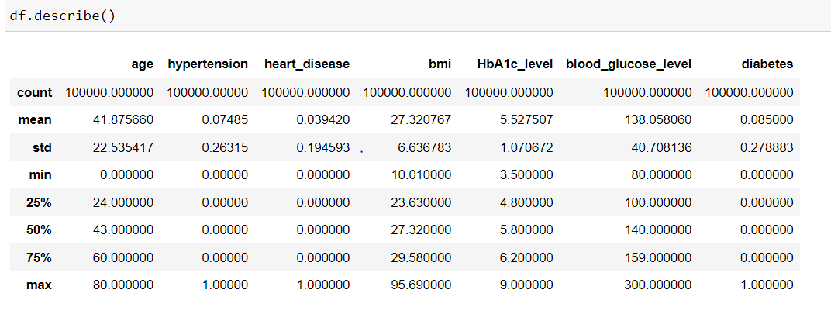
Data Cleaning
After this we checked for the None values in other Predictors which are in shape of some extreme values like 999 for age but we didn’t find such values as we can see from below.

Slide 12
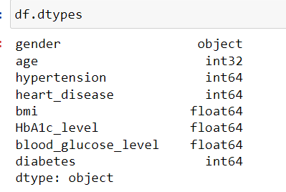
Data Cleaning
We are finished with Data Cleaning process for the Diabetes Prediction Dataset. Below are the final columns and their data types.
Age is a discrete variable here, hence we converted it into int type and blood_glucose_level is a continuous variable, and thus it was converted into float.

Slide 13
Part 2: Exploratory Data Analysis(EDA)

Slide 14
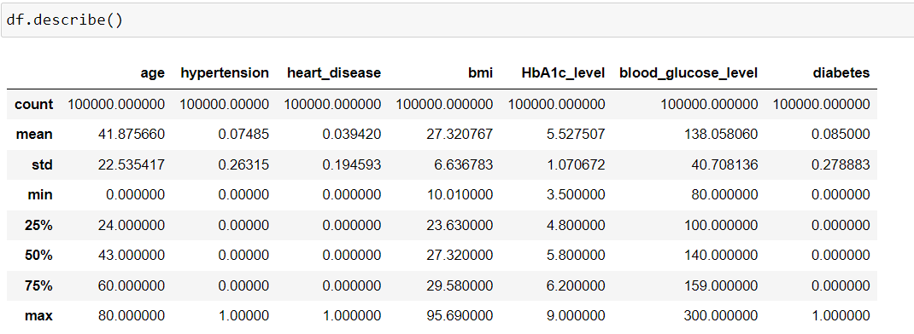
Exploratory Data Analysis(EDA)
During the EDA part we will draw various plots, extract descriptive statistics, and analyze preliminary relationships across the different Columns of the Data Set.
We will start with basic descriptive statistics.

Slide 15
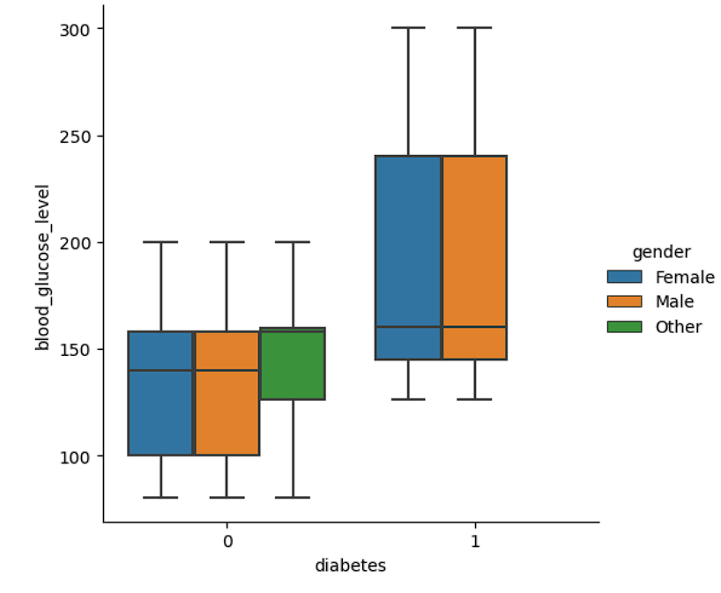
Exploratory Data Analysis(EDA)
Box Plot for Diabetes Vs Blood Glucose Level seems same for all the genders, Other Gender looks different in first glance but it can be due to the reason that only 18 entries were availaible for them in the dataset.

Slide 16
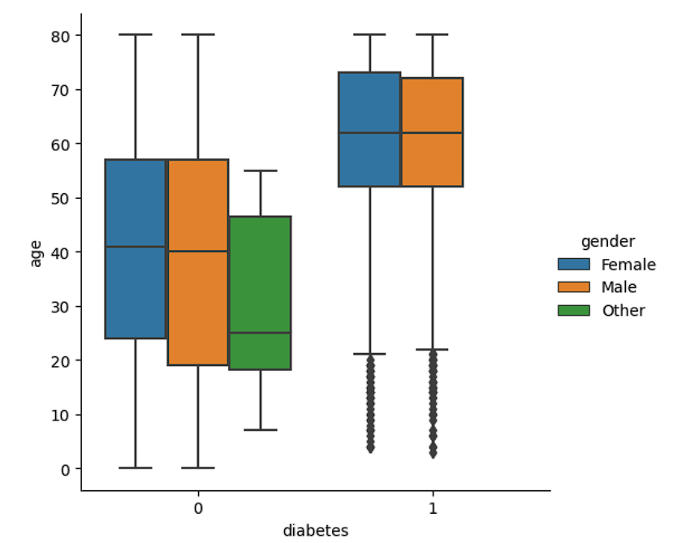
Exploratory Data Analysis(EDA)
From the above boxplot for Diabetes vs Age we can see that most of the patients with Diabetes have high Median Age and generally higher age with a few outliers where people under 20 also have diabetes.

Slide 17
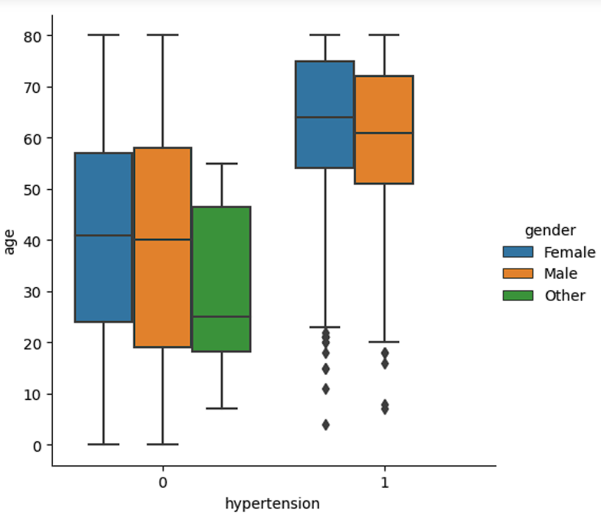
Exploratory Data Analysis(EDA)
Hypertension Vs Age boxplot based on the Gender appear similar to the Diabetes Vs Age, which was expected because generally most patients for Diabetes have high Median age and around age the likelihood of the Hypertension also increase naturally. Age can be called as a confounding factor here.

Slide 18
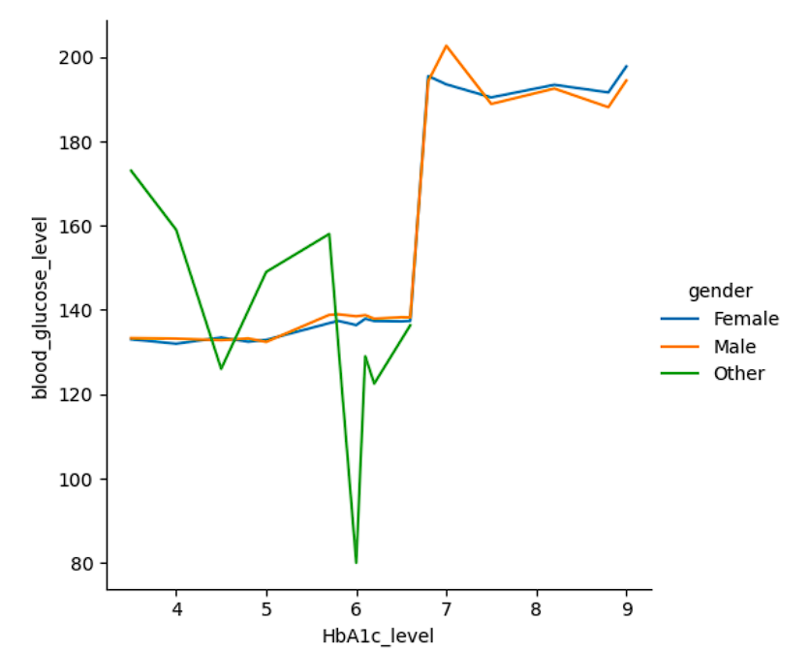
Exploratory Data Analysis(EDA)
HbA1c Level and Blood Glucose Level for both Male and Female gender appears same.
While other gender may look like that it has different shape it may be due to the fact that only 18 observations of such types were recorded.

Slide 19
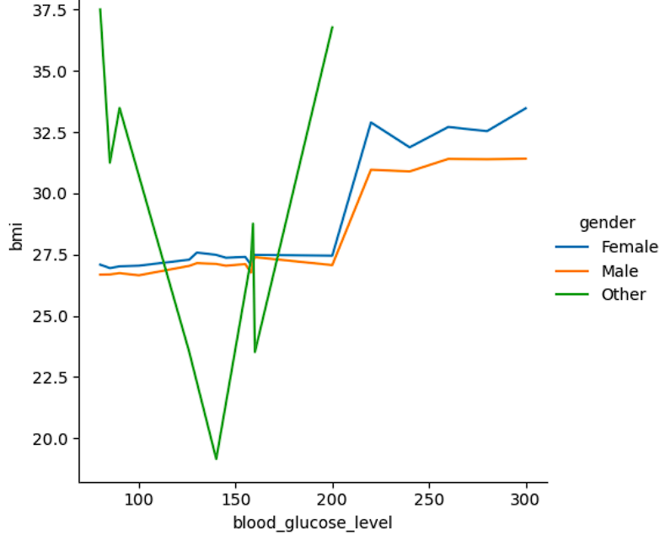
Exploratory Data Analysis(EDA)
BMI for Female appears to be more than Male for each level of blood_glucose_level.
Again we got abnormal result for Others. This may be due to the fact that only 18 observations were recorded representing them.

Slide 20
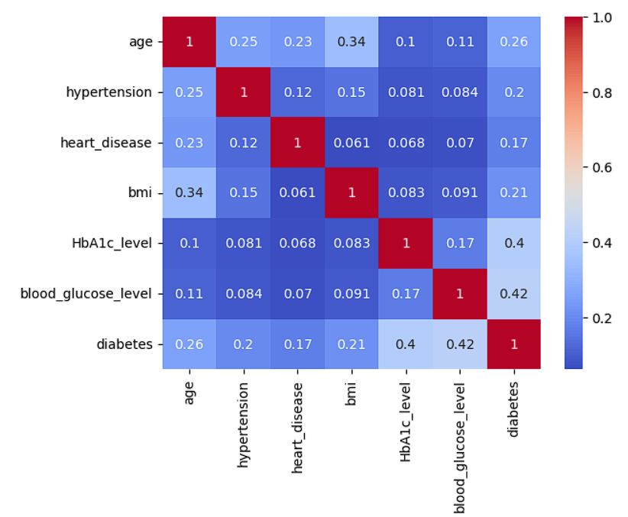
Exploratory Data Analysis(EDA)
Finally from the Heatmap we can see that there does not exist an evidence for collinearity prima facie.
While there can be multicollinearity, we would need the help of subject matter expert to find it as there is no high correlation, that is > 0.7, in our given data set with which we can find collinearity.

Slide 21
Part 3: Models

Slide 22
Introduction
In this part we will use the Clean Data to create different kind of models for predicting Diabetes based on the Design Matrix. We will split the data set into training and test with test training size having dimension (20,000, 8). We will train the models on the Training Data and then use the Test Data for further testing. We will hence only cover Accuracy scores for the Test Data for the Models.

Slide 23
Introduction
Models Covered in this Section:
Logistic Regression
Random Forest
Ada Boost
Gaussian Naive Bayes
Multinomial Naive Bayes
Linear Support Vector Machine

Slide 24
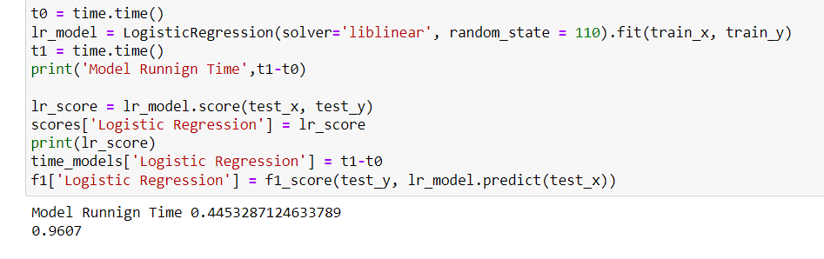
Logistic Regression
Logistic Regression is a simple model with high bias but less Model Variance
Logistic Regression is based on 8 Predictors only and since there was no correlation across the predictors there will be no need of Feature selection for the Logistic Regression. [F1 Scores will be used in Model Comparison Part]

Slide 25
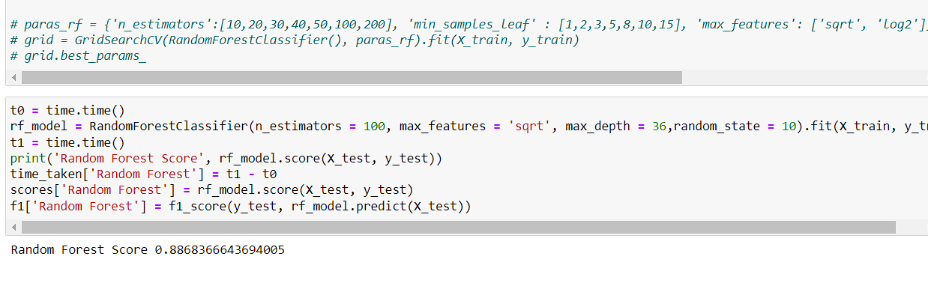
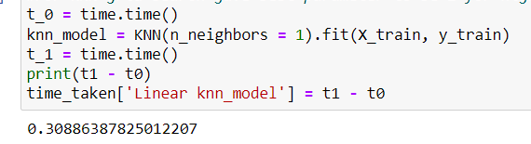

Random Forest
Random Forest is an ensemble method based on the random set of Predictors
Code of Random Forest with its Hyperparameters Grid Search.

Slide 26
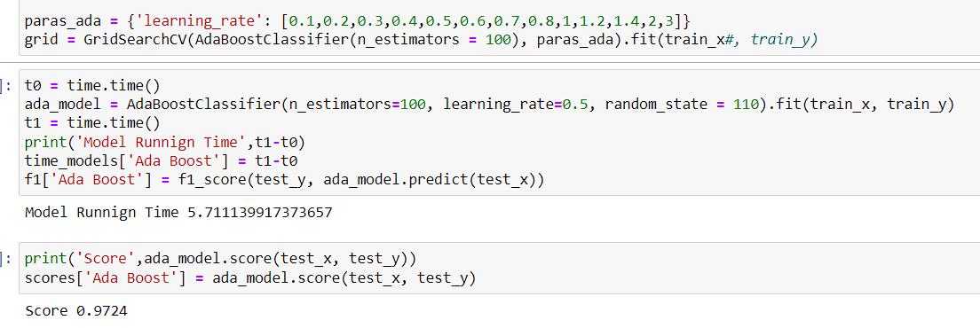
Adaboost
Adaboost is an Ensemble boosting algorithm based on Stumps
Code of Adaboost with its Hyperparameters. N_estimator is also taken based on the GridSearchCV but because it was taking too much time and we wanted to fine tune learning rate we took it for default for the second grid search.

Slide 27
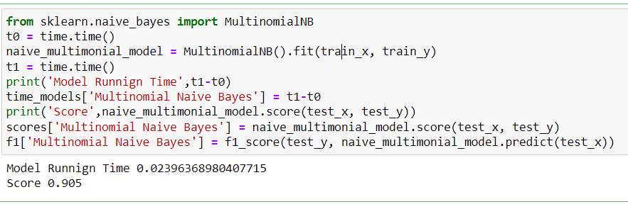
Multinomial Naive Bayes
Multinomial Naive Bayes is a popular Bayesian Supervised Learning Algorithm
Multinomial Naïve bayes is a simple model and don’t need much hyperparameter tuning. Default works fine here.

Slide 28
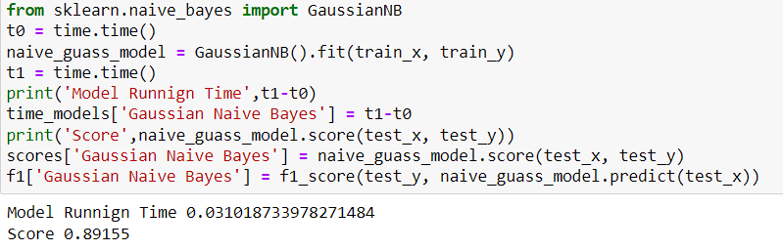
Gaussian Naive Bayes
Gaussian Naive Bayes is a popular Bayesian Supervised Learning Algorithm
Gaussian Naïve bayes is a simple model and don’t need much hyperparameter tuning. Default works fine here.

Slide 29
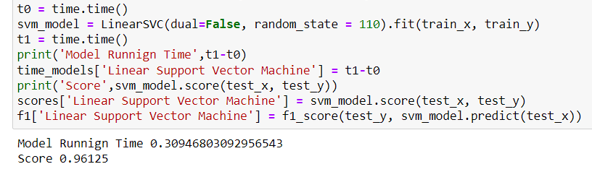
Linear Support Vector Machine
Linear SVM is a powerful soft margin classifier.
While SVM is indeed powerful, for this model we can not fit it using SVC and can’t even tune the hyperparameters like its loss function. Due to the model having 8 Predictors only SVM is having problem here and is generally not an appropriate model.
Nevertheless, even linear SVM produced great Score.

Slide 30
Part 4: Result and Analysis

Slide 31
Introduction
Now we have created various models while optimizing their Hyperparameters for the Diabetes Prediction. We are now equipped to suggest the model which will be most useful to use the users like Health Care Professionals.
To analyse the result in a tabular form we will create a full DataFrame with Models, Scores(Accuracy), Time, and F1 Scores.

Slide 32
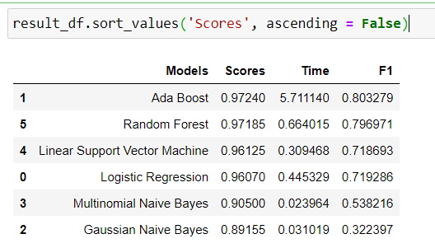
Result

Slide 33
Result Table
In the Result Data frame we have Scores, time taken, and F1 values.
Scores measure the Accuracy for the Test Data Set.
Time taken refers to the Time elapsed for 1 iteration of the model. More complex model takes more time.
F1 Score is a representative of Precision and Recall. High F1 Score means higher of both of them and is considered optimum for a model.

Slide 34
Analysis
Best model for Predicting the Diabetes Patients is Adaboost Model as it has the highest accuracy of 0.97240 and highest F1 value at 0.803279.
Simple models like Naïve Bayes has lower Accuracy score with Gaussian Naïve Bayes having lowest Score at 0.89155.
Generally, as we are taking more complex model, while optimizing for there hyperparameters, we are getting models with better accuracy score and F1 score, which we would prefer as our task is for predicting Diabetes.

Slide 35
Summary

Slide 36
Summary
Overall, our problem was predicting the Diabetes Patients and Adaboost model is the best Predictor with the accuracy of 0.97240 among all the 6 Tested Model.
If we want utmost prediction we recommend Adaboost, however if slight amount of Accuracy can be sacrificed Random Forest appears to be a competent Model for our problem, it is taking only fraction of time as compared to Adaboost and has high accuracy rate of 0.97185 and high F1 score of 0.7969, both of which are only a few points below the result metrics of the best model, Adaboost.
Hence, if most prediction is required we suggest Adaboost. If user can tolerate a bit lower prediction we would suggest Random Forest. Different users like Health Care professionals and the Businesses can use different models in such case, with Health Care professional using Adaboost for additional accuracy.

Slide 37
Appendix

Slide 38
Kaggle DataSet = https://www.kaggle.com/datasets/iammustafatz/diabetes-prediction-dataset

